Slide 1
HAP SSC
Supporting Documents for Landlords
HAP Online Portal for Tenants

Slide 2
Portal Registration
Applying for Housing Assistance Payment
Register Tenant Portal
Please note that you will need to first register on the Portal if you have not previously registered.
Existing Tenant
New Tenant
MyGovID verified accounts

Slide 3
Register as a new Tenant
Select user type: Tenant
Full Name
Email
Contact Number
Password
Register

Slide 4
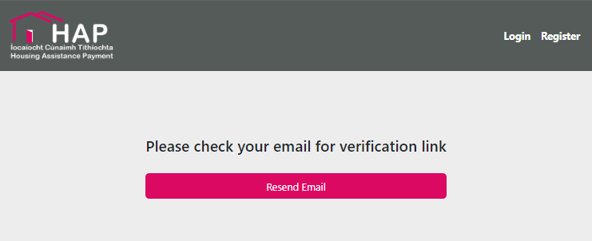
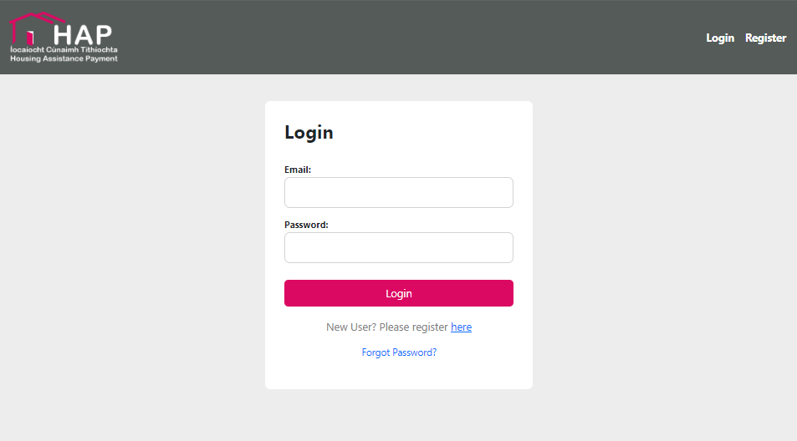
Register as a new Tenant
Email Verification Link
Email Verified login
Login using details submitted when registering

Slide 5
Register as a new Tenant
Each time you log in you will be sent a passcode by text message which is required to verify your identity
Select New Application

Slide 6
Online Portal Application
Application Details
Household Income
Household members
Property to Rent
Declaration
Uploads

Slide 7
Application Details
Local Authority you are applying to - please select DRHE if applicable
Your Social housing reference number.
Tenant type, please confirm either single or joint. If joint application is selected please populate the relevant fields

Slide 8
Application Details Continued
PPSN
Your full name
Gender
DOB
Phone no
Email
Full address including eircode

Slide 9
Household Income
Income details
Proof of Social Welfare payments
Evidence of any maintenance payments been made or received

Slide 10
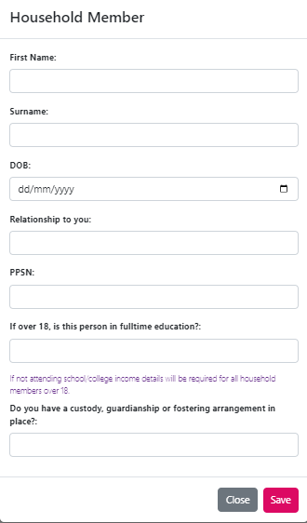
Household members
Add Household Members
Name
Date of Birth
Relationship to you
PPSN
Confirm if over 18 and in education
Custody, Guardianship or fostering arrangement in place
Submit documentation as required

Slide 11
Property to Rent
Eircode or full address
Confirm any family relationship to Landlord
Bedrooms in property
Is the property shared
Monthly rent for the whole property
Date you moved in
Date rent paid up to
Are you receiving rent supplement

Slide 12
Declaration
Review all Terms, Conditions and Declarations
Signatures Required
Date of submission

Slide 13
Uploads
View uploaded Documentation Submitted

Slide 14
Reason for Rejections
Required Fields were not all filled in.
Insufficient information submitted
Missing documentation
Local Authority rejection

Slide 15
Queries on HAP application
For any queries please refer to the accompanying video on documents type and information requirements
Contact the HAP section of your local authority

Slide 16
HAP SSC
Supporting Documents for Landlords
HAP Online Portal for Tenants

