Slide 1
HAP SSC
Supporting Documents for Landlords

Slide 2
Main supporting documents required from Tenants:
Current payslips
Social Welfare Receipts
Employment Detail Summary / Statement of Liability
Lease Agreement
Irish Residence Permit
Letter from school / college

Slide 3
PAYSLIPS & SOCIAL WELFARE PAYMENTS
Payslips can be uploaded in JPEG or PDF format
Social Welfare Payments
Proof of Child income
Mywelfare.ie

Slide 4
Employment detail summary & statement of Liability
Employment history
Log into ‘My Account’ on www.revenue.ie

Slide 5
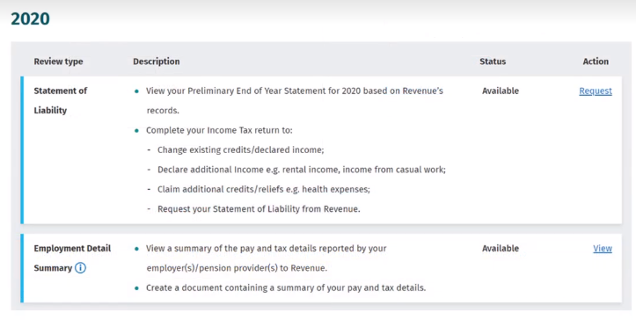
Employment detail summary & statement of Liability
Click ‘Review your Tax’
Download your most recent Employment Detail Summary (Usually for the previous year) in pdf format.

Slide 6
Employment detail summary & statement of Liability
Upload the previous year’s Employment Detail Summary. Eg for 2023, 2022 documentation required
Statement of Liability

Slide 7
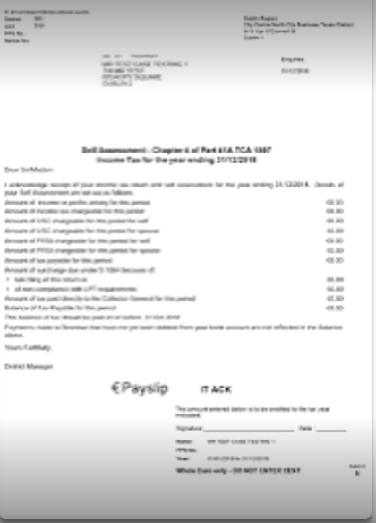
CHAPTER 4 SELF ASSESSMENT
For applicants who are self employed, HAP require your End of Year Self Assessment or Chapter 4

Slide 8
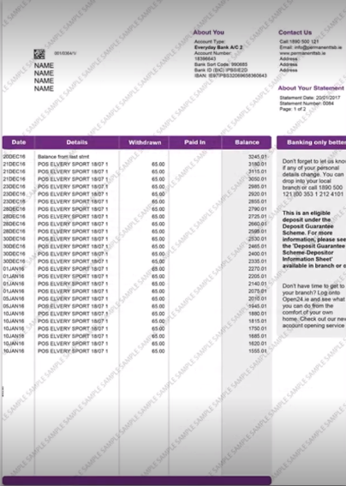
BANK STATEMENT
For all other income you can upload your bank statement.
This would be for any other income such as maintenance, private pension, etc.

Slide 9
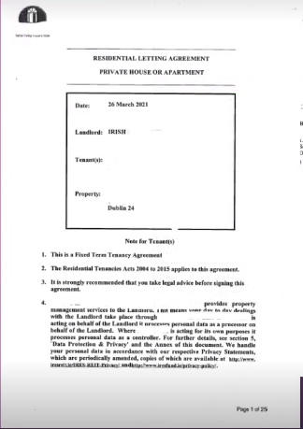
LEASE AGREEMENT
Each Applicant must upload the lease agreement for the property you wish to apply for a HAP payment
Tenant and Landlords name
Property
Schedule

Slide 10
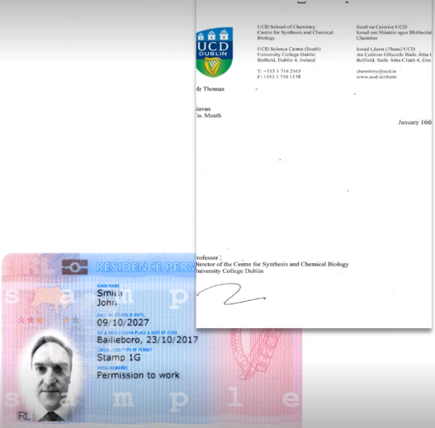
OTHER DOCUMENTS
Applicants who are in full time education or have family members who are over 17 and are in full time education require a letter confirming admission
Some applicants may need to upload their Irish Residence Permit card depending on their residency status.

Slide 11
HAP SSC
Supporting Documents for Landlords

