Slide 1
HAP SSC
Supporting Documents for Landlords

Slide 2
Main supporting documents required from Landlords:
Bank Header
Proof of Ownership
Tax Clearance Certificate
Rent Pressure Zone calculation

Slide 3
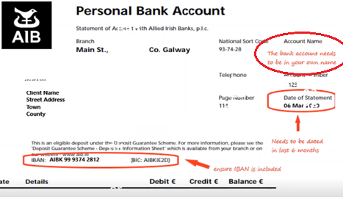
Full Bank Header
BIC, IBAN and the name of the account holder the HAP payment will be made payable to
The bank header needs to state statement header and be dated within 2 years
If the Landlord is already in receipt of HAP payments for an existing HAP tenancy, the payments will be made to the existing bank account
The name on the bank account must match the name on the tax reference number and/or PPSN
If the proof of ownership is in the names of joint owners but the bank account is in the name of one owner, a letter from the joint owner(s) authorising the HAP payment to be made to one owner must be submitted.
A nominated agent collecting on behalf of the Property Owners will require written permission to collect on their behalf.

Slide 4
Bank Header Most common reasons for this document being returned
A Full Bank header is not submitted omitting details.
The name on the bank header does not match the name given on the HAP application form
The bank header name does not match PPSN supplied
The statement does not show the account holder’s name
The copy is not clear. The document must be clearly legible
The BIC and IBAN do not match the submitted application
The bank header is dated more than 2 years ago
AIB Headers need the account name to match. The person that the letter is addressed to is not accepted.
The bank header must be a statement.

Slide 5
Proof of Ownership
The Landlord must provide one valid proof that they own the property. If the document is not valid, it should be returned to the Landlord and this may affect the start date of the HAP Payment.
The document provided must contain the following:
Be in date
Include the landlord’s name
Include the full address of the rented property, including the apartment number (if applicable)
The landlord’s name and the property address being rented must match the details provided on the HAP application form
Certain criteria is required for each type of proof

Slide 6
Proof of Ownership
RTB Registration Letter
Current Insurance Policy or Insurance Schedule for the Property
Evidence of Payment of Current Local Property Tax (LPT)
Mortgage Statement for the Property within 12 months
Title Deed or Similar Legal Instrument Proving Ownership of the Property

Slide 7
RTB Registration Letter
The Landlord can provide a landlord tenancy confirmation letter of registration i.e. letter addressed to landlord, from the Residential Tenancies Board (RTB) or an email from automailer@rtb.ie showing registration with the RTB
The registration of the tenancy must be in date at the time of the application for HAP – tenancies must now be registered annually since 04/04/2022
The address of the HAP property on the document must match the address given on the HAP application form

Slide 8
RTB Registration
Common reasons for RTB Registration documents being returned :
The letter is addressed to the tenant and not the landlord
Registration is out of date, tenancies must now be registered annually since 04/04/2022
The address of the HAP property on the document does not match the address provided on the online application
The property is registered by an agent and the landlords name is not visible on the confirmation letter
A letter from the RTB stating that the tenancy needs to be re-registered is not acceptable

Slide 9
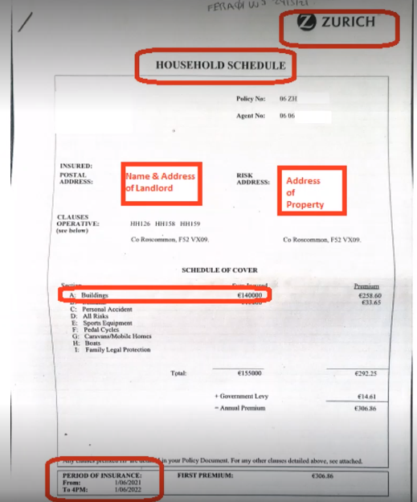
Insurance Policy
The Landlord can provide an insurance policy or schedule which proves that you have current buildings insurance for the property. The document must show the following:
Landlord’s name – which must match the application
Property address – which must match the property address given on the application
Period of cover including start and end date
Policy number and buildings value insured
Be on headed paper clearly identifying the insurance company

Slide 10
Insurance Policy
Some common reasons for this document been returned are:
The insurance policy is not current, the document is for an older policy or a policy which hasn’t started yet
The address on the document does not match the address provided on the application form
The policy is not in the Landlord’s name or the name on the policy does not match the name on the application form
A renewal notice is provided without a receipt matching the policy number or items above
A brokers letter will not be accepted

Slide 11
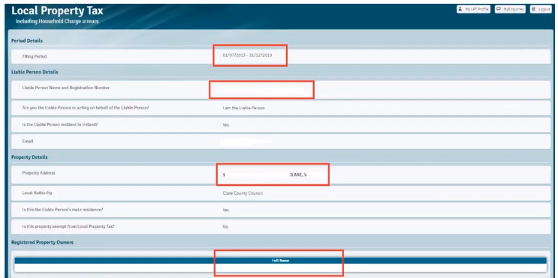
Local Property Tax
The Landlord must provide proof that they have paid their Local Property Tax from the LPT Website. The document must show the following:
Landlord’s name – which must match the application form
Property address – which must match the property address given on the application form
Be dated within the current year and show payment history
If the property is an apartment, the apartment number must be included
If the property is jointly owned, you need to send a letter from the joint owner(s) authorising the HAP payment to be made to one owner

Slide 12
Local Property Tax
Some common reasons for this document been returned are:
The document is out of date, it must show evidence of payment of the Local Property Tax for the property for the current year
The Local Property Tax has not been paid or not set up for payment e.g. SEPA Direct Debit, deduction at source for the current year
The landlord’s name is not on the document or does not match the name given on the HAP application form
The property is a flat or apartment and the Local Property Tax has been paid for the whole building. Apartments and flats must be declared individually to Revenue

Slide 13
The way to provide proof of current Local Property Tax payment is to give two screenshots from the Local Property Tax section of Revenue’s website: https://lpt.revenue.ie

Slide 14
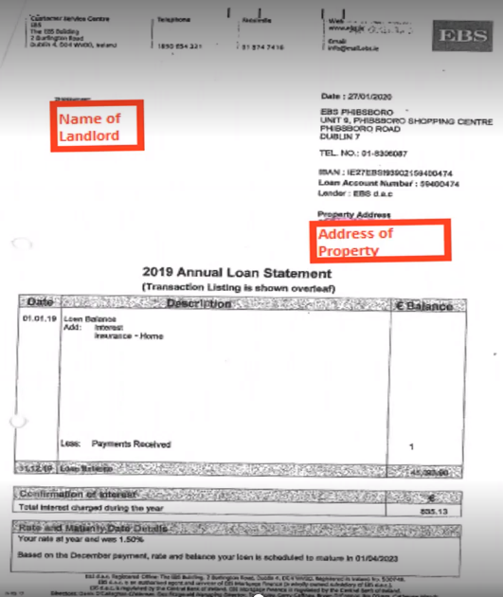
Mortgage Statement
The Landlord can provide a copy of a current mortgage statement for the property. The document must show the following:
Landlord’s name – which must match the application
Property address – which must match the property address given on the application form
Dated within the last 12 months i.e. last annual mortgage statement received

Slide 15
Mortgage Statement
Some common reasons for this document being returned are:
The mortgage statement is in a different name than the landlord name on the application
The address on the document does not match the address provided on the application
The statement is older than 12 months
The mortgage statement does not include the period to which the statement relates

Slide 16
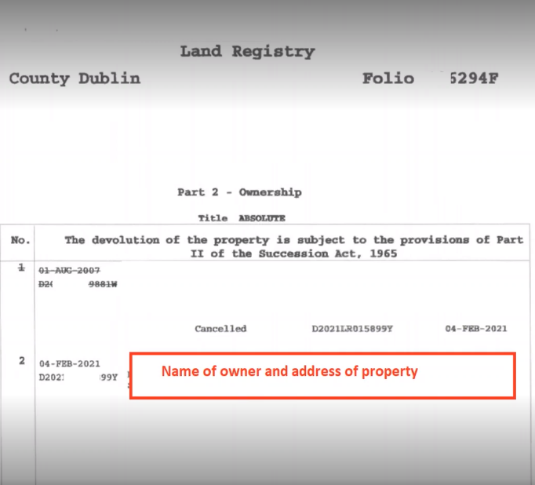
Land Registry/Folio
Landlords can provide a copy of a folio / title deed for the property. The document must show the following:
Landlord’s name – which must match the landlord’s name given in the HAP application
Property address – which must match the property address given in the HAP application as confirmed on land direct.

Slide 17
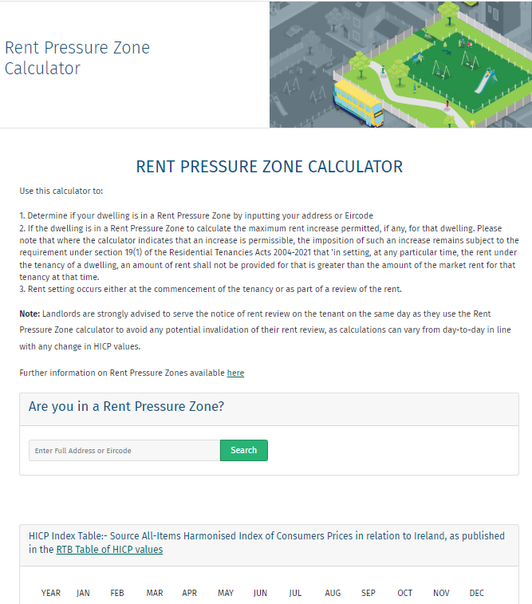
Rent Pressure Zone Statement
A Rent Pressure Zone (RPZ) is a designated area where rents cannot exceed general inflation
Rent Pressure Zones are located in parts of the country where rents are highest and rising
Properties rented for the first time must show the RTB tenancy details to confirm the amount the rent has been set at for any future increases

Slide 18
Tax Clearance Certificate
To receive HAP payments, the Landlord must be tax compliant. They’ll be asked to certify that they are tax compliant as part of the tenant’s HAP application
Revenue may rescind their Tax Clearance Certificate at any time. It is advised to check that they have a valid Tax Clearance Certificate to receive their monthly payments

Slide 19
HAP SSC

