Slide 1
HAP SSC
Supporting Documents for Landlords
HAP Online Portal for Landlords

Slide 2
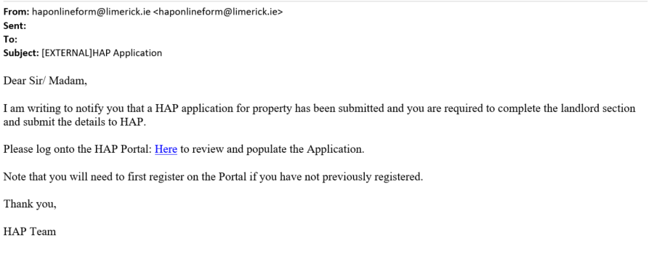
Portal Registration
Once your tenant has registered with HAP you will receive an email notification inviting you to register as a HAP Landlord.
Click on link in email to review and populate the Application
Please note that you will need to first register on the Portal if you have not previously registered.

Slide 3
Register as a new Landlord
Select user type: Landlord
Full Name
Email
Contact Number
Password
Register

Slide 4
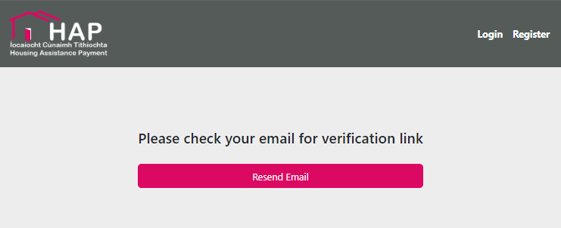
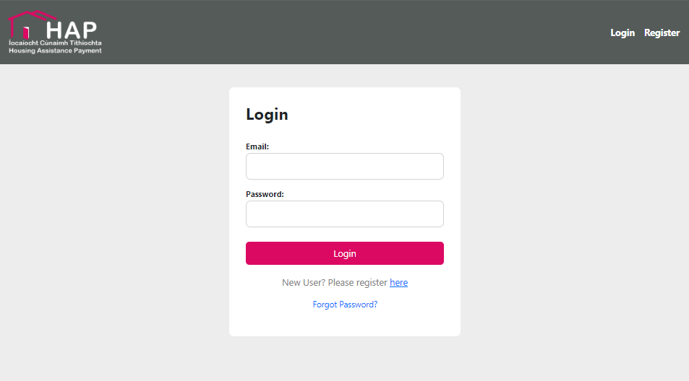
Register as a new Landlord
Email Verification Link
Email Verified login
Login using details submitted when registering

Slide 5
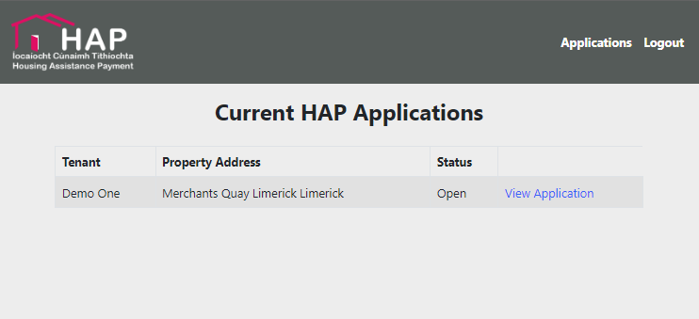
Register as a new Landlord
Each time you log in you will be sent a passcode by text message which is required to verify your identity
View Application you wish to view

Slide 6
Online Portal Application
PAYEE-Person/Persons Receiving Rent Payment
Property Details
Tenancy Details
Landlord Signatures
Uploads

Slide 7
PAYEE-Person/Persons Receiving Rent Payment
Who will receive payment?
Name
Tax Number / PPSN
Existing HAP Landlord
Irish Resident Status
Contact Number

Slide 8
PAYEE-Person/Persons Receiving Rent Payment
Bank details
Headed Bank Statement
Proof of Ownership
Tax Clearance
Landlord/Agents Address
Uploads are required for Bank header, Proof of Ownership in order for your submission to proceed

Slide 9
Property Details
Property address
Local Property Tax Identification
Confirmation of who is receiving payment
Property Ownership
Confirmation of permission of payment if required.

Slide 10
Tenancy Details
Name of Tenant or Tenants
Relationship to Tenant
Number of Bedrooms in the property
Property Type
Is the Property Shared?
Monthly Rent
Tenancy Agreement
Rent Book

Slide 11
Tenancy Details
Start Date of the Tenancy
Existing Tenants Date
Date rent is paid up to
Deposit for property
Confirmation if the Deposit has been paid

Slide 12
Landlord Signatures
Review all Terms, Conditions and Declarations
Signatures Required
Date of submission

Slide 13
Uploads
View uploaded Documentation Submitted

Slide 14
Reason for Rejections
Required Fields were not all filled in.
Insufficient information submitted
Missing documentation
Local Authority rejection

Slide 15
Queries on HAP application
For any queries please refer to the accompanying video on documents type and information requirements
Contact the HAP section of your local authority

Slide 16
HAP SSC
Supporting Documents for Landlords
HAP Online Portal for Landlords

